Slide 1
Reopening the Shellfish Beds in Duval County
Jacksonville Waterways Commission
October 11, 2017
William Karlavige
Water Quality Scientist
Environmental Quality Division

Slide 2
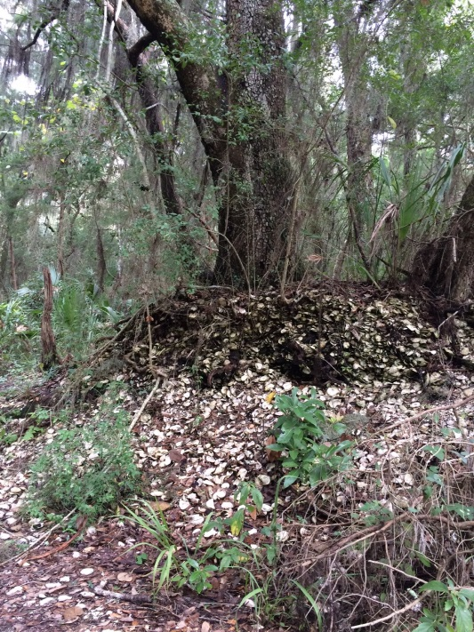
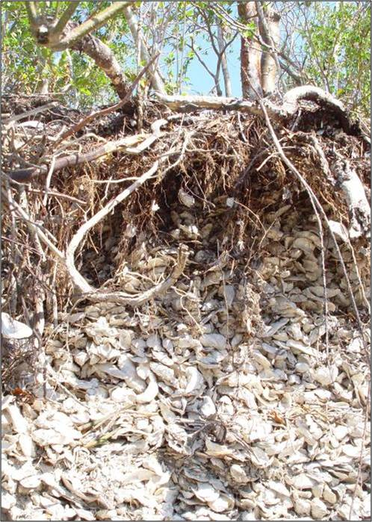
A Brief History of Shellfish Harvesting
Oysters have been an important component of the diet of coastal inhabitants of Northeast Florida for over 5,000 years.
Shell Middens
1924 - Typhoid Outbreak in Northern U.S. Cities
150 people died out of 1500 sick
This caused a near collapse of the shellfish industry
National Shellfish Sanitation Program (NSSP) - Regulations

Slide 3
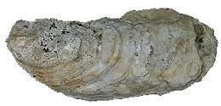
In the 1960’s, certain areas in Duval County were officially approved for harvesting, including waters in the Timucuan Ecological and Historic Preserve.
A 1979 report stated many of the monitoring stations did not meet the NSSP’s recommended criteria for approved waters.

Slide 4
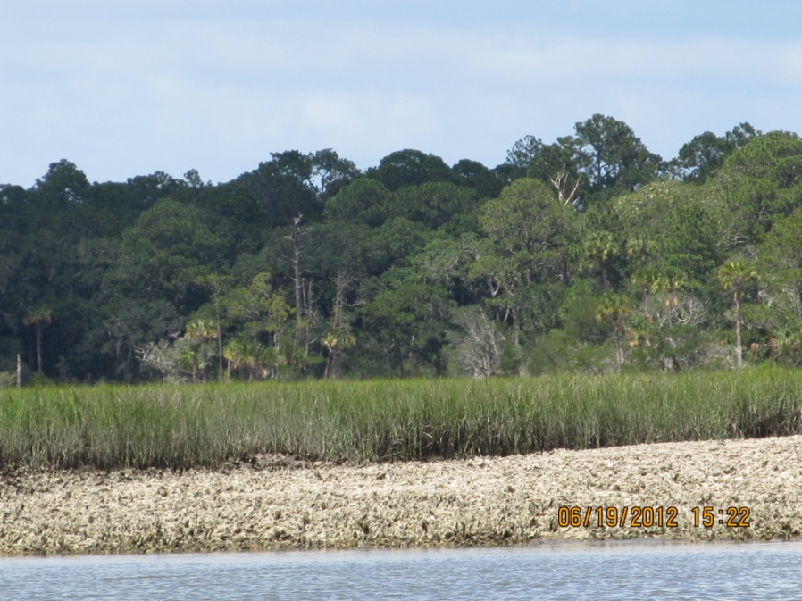
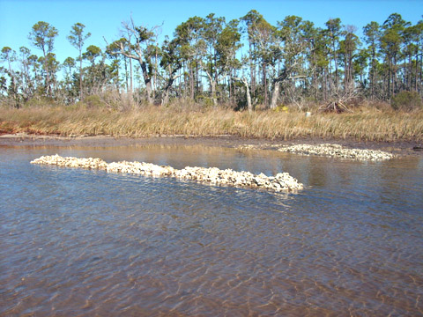
In 1986, the Florida DNR planned to completely close the local beds, even though high bacteria levels could be predicted by monitoring salinity levels, but the equipment needed was deemed too expensive.
This closure plan was successfully fought by local commercial harvesters and fishermen.
In 1987, a $75,000 remote salinity monitor was installed.
The area was reclassified as Conditionally Approved, with temporary closures occurring during reduced salinities.

Slide 5
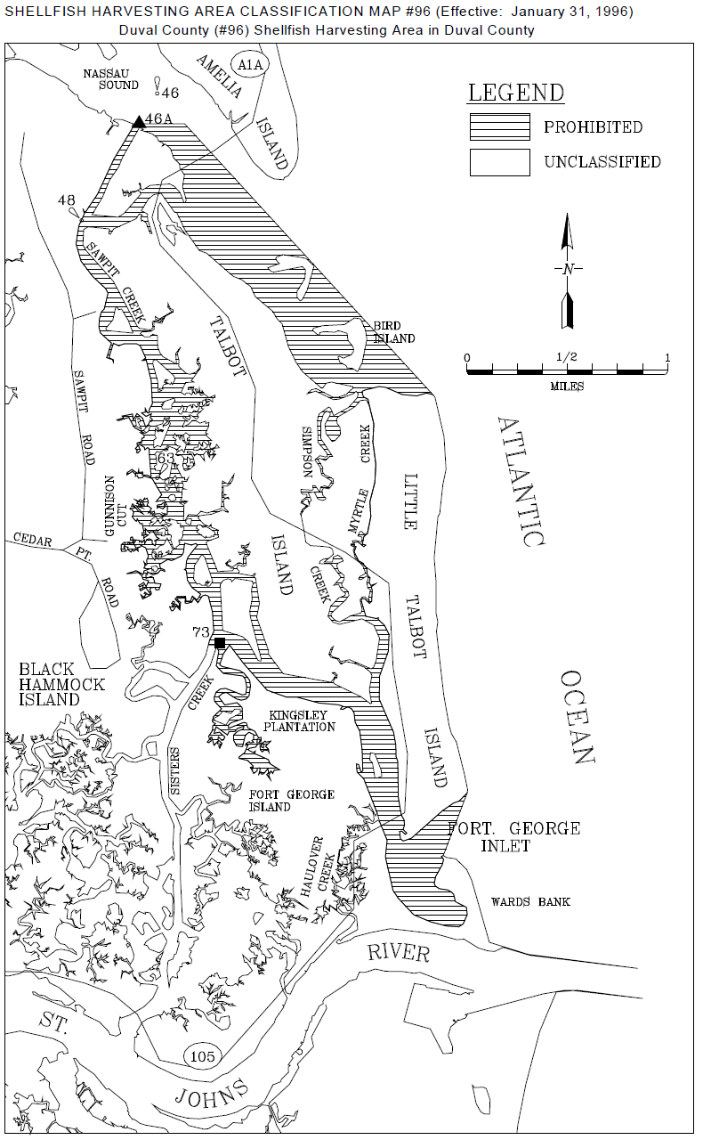
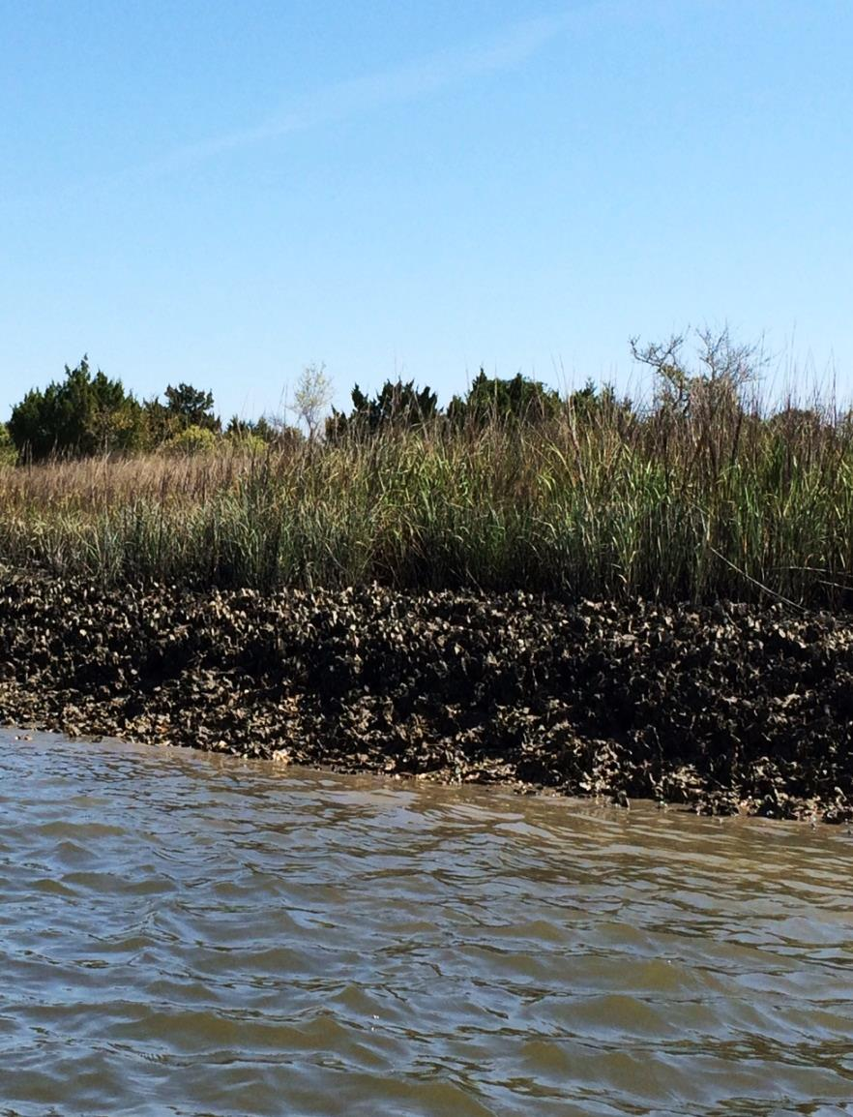
Shellfish Harvesting Area

Slide 6
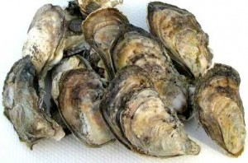
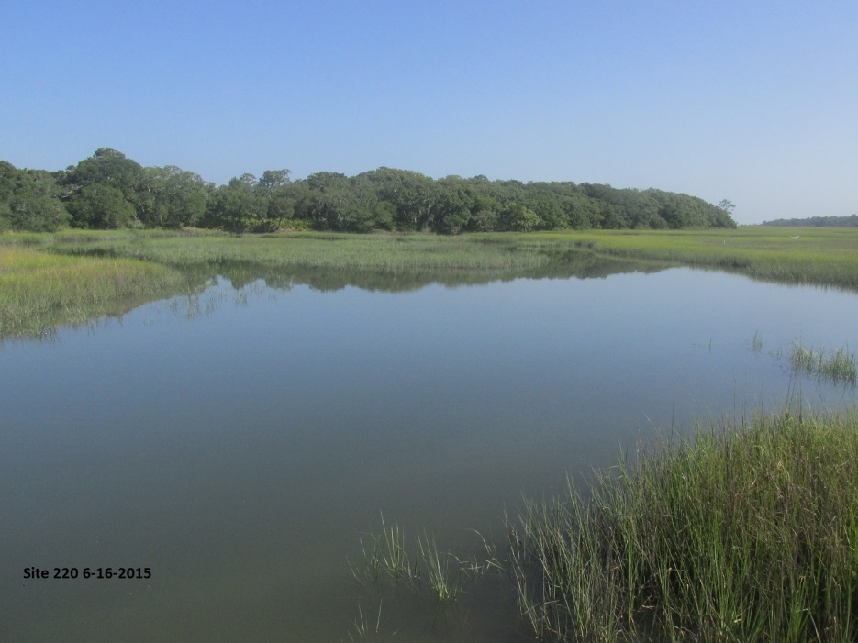
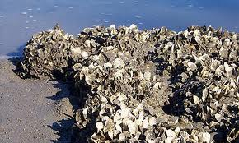
What Changes have Occurred since 1996?
Eastern Oyster, or Atlantic Oyster, Crassostrea virginica

Slide 7
 | Preliminary Cost Assessment to Evaluate Current Water Quality Conditions in Duval County Shellfish Areas
 | March 15, 2013
 | Sampling Description
 | Number stations | Times / Year | Duration Years | Total Samples
 | 30 | 24 | 2 | 1440
 | Effort Required
 | Staff Samplers per trip | Times / Year | Duration Years | Total Staff Trips | Hours per Trip Including Prep Time | Average Salary with Benefits | Staff Cost
 | 2 | 24 | 2 | 96 | 14 | $60 | $80,640
 | Data entry, Review, QA |  |  |  | Total Hours
 | 12 | 12 | 2 |  | 288 | $60 | $17,280
 | Project Management, | Data Analysis, Reporting |  |  | Total Hours
 | 16 | 12 | 2 |  | 384 | $60 | $23,040
 | Other Expenses
 | Lab Analysis: Fecal Coliform | Samples | 1440 | $42 | EQD Lab = $39 Contract = $45 |  | $60,480
 | Analysis : DO, pH, turbidity, salinity, temperature, depth | Trips | 48 | $300 |  |  | $14,400
 | Sample Shipment to DACS Lab | Shipments overnight | 12 | $100 |  |  | $1,200
 | Boat, fuel, equipment | Trips | 48 | $800 |  |  | $38,400
 | TOTAL |  |  |  |  |  | $235,440
Notes:
.

Slide 8
Duval County Oyster Beds
Preliminary study on the bacteria levels
Larger effort was feasible

Slide 9
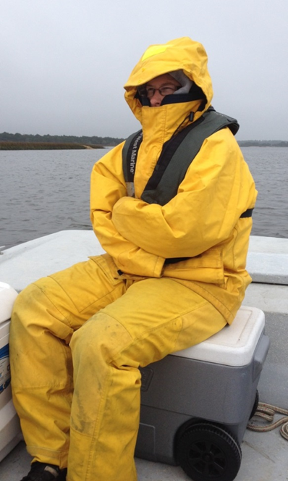
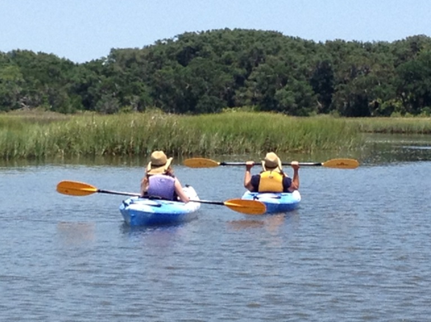
Preliminary WQ Assessment
With volunteers and existing resources
24 months of water quality samples
Sampling in all adverse environmental conditions:
Rainfall events
High & low water levels
Warm and cold weather
Various tidal conditions

Slide 10
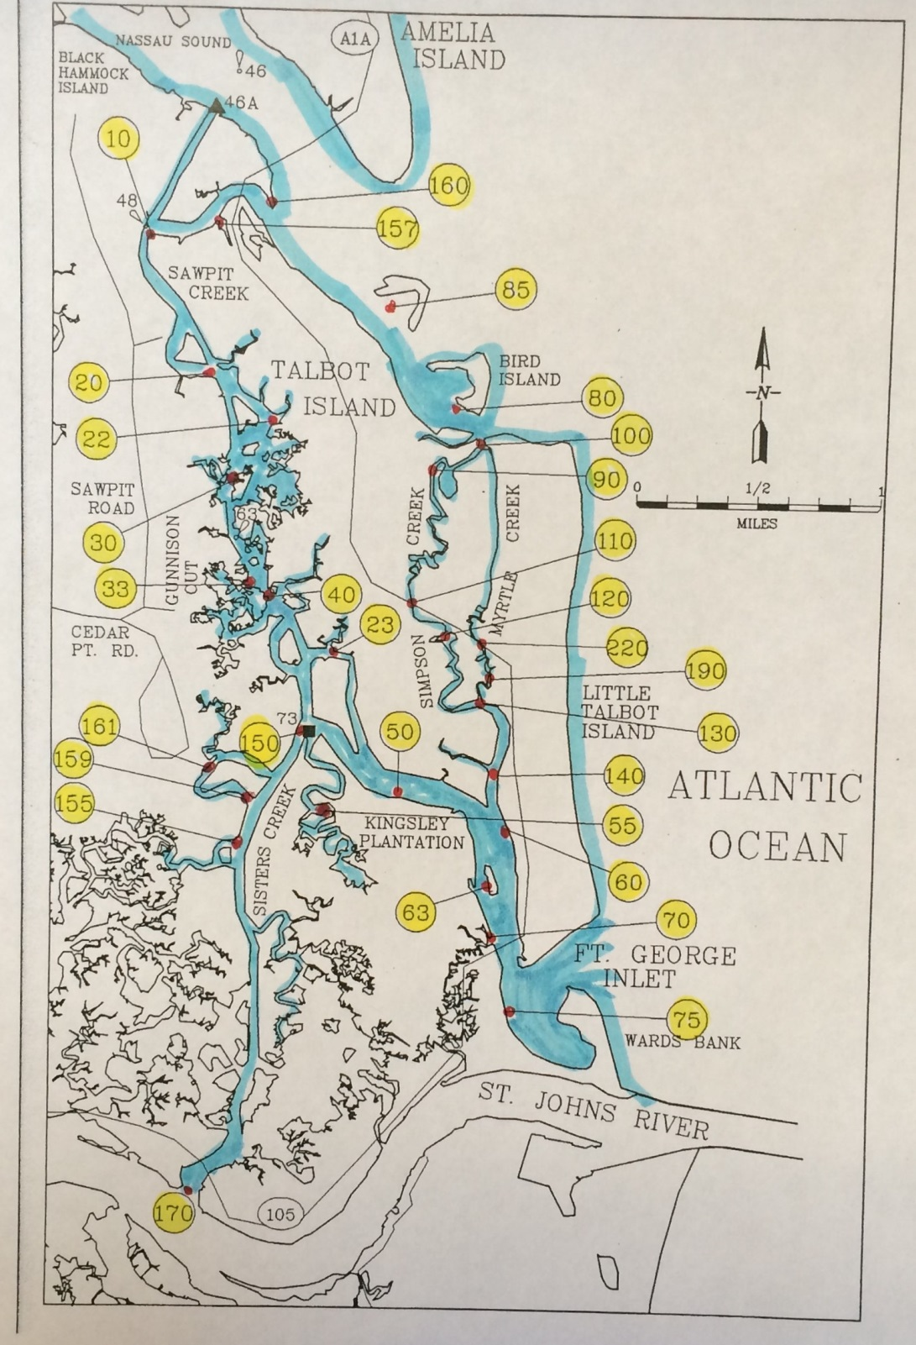
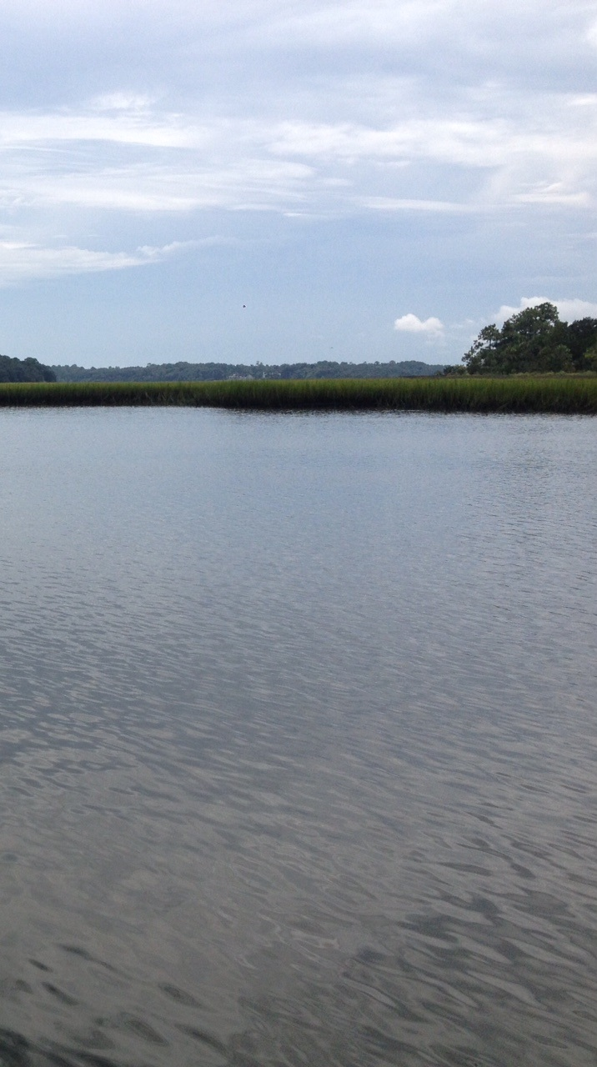
30 Sample Sites

Slide 11
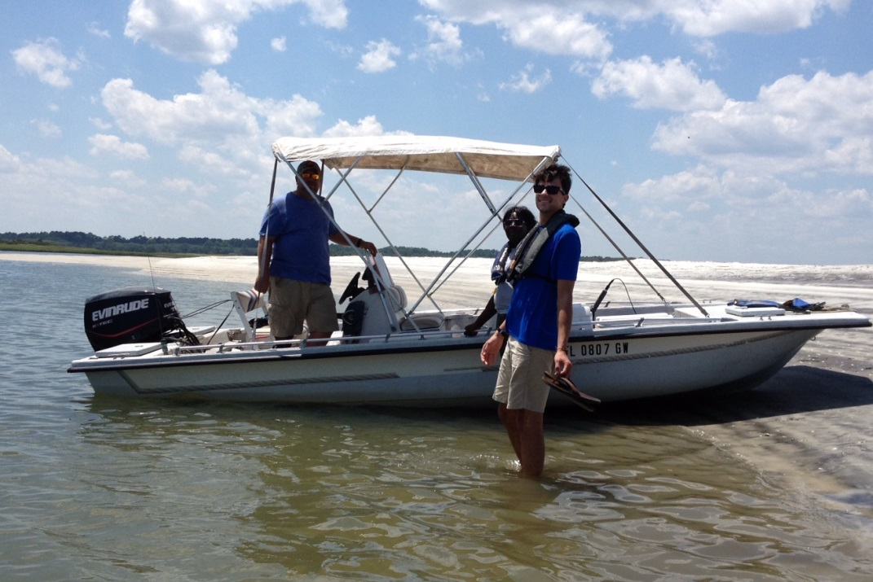
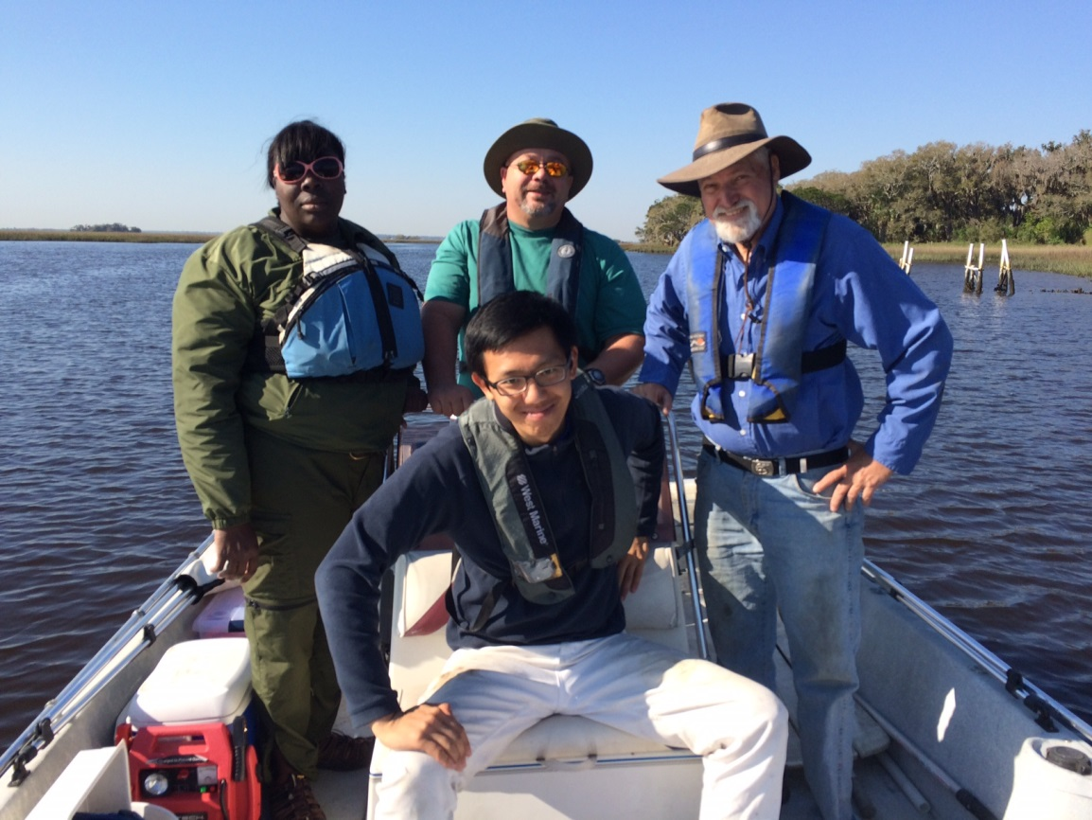
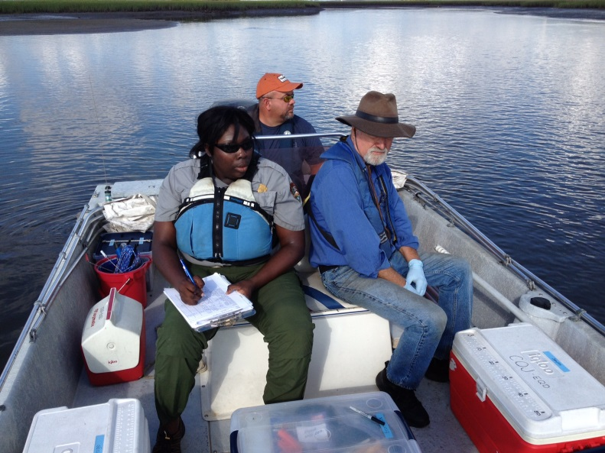
EQD Sampling Began in December 2013

Slide 13
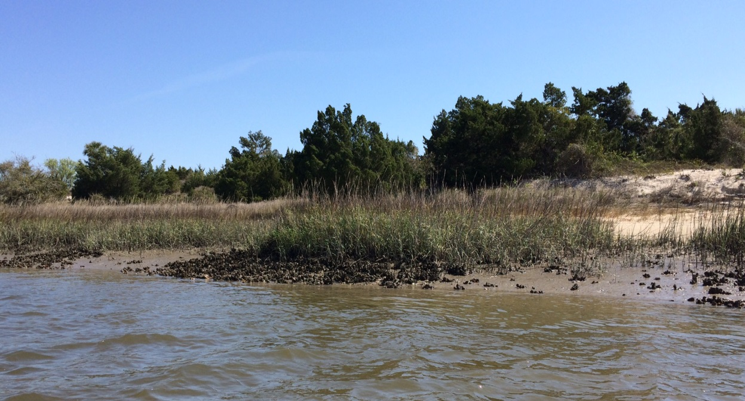
Discussion of Results with DACS Division of Aquaculture Shellfish Environmental Assessment Section (SEAS)

Slide 14
When we consider attempts at reopening the beds:
We need to determine what areas would be open for recreational and commercial harvesting?
How many oysters are available for harvesting?
Are our oysters healthy and resilient enough to withstand harvesting?
How is the harvesting going to affect the WQ?
Oysters filter 50 GPD

Slide 15
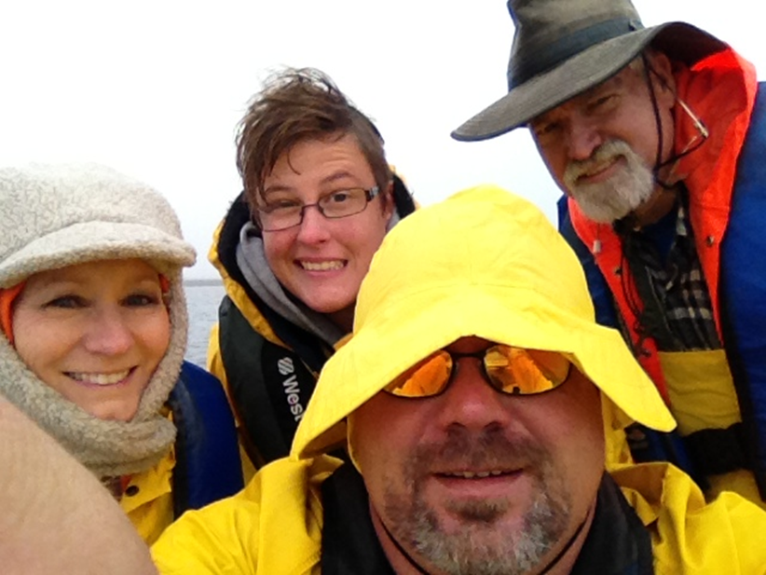
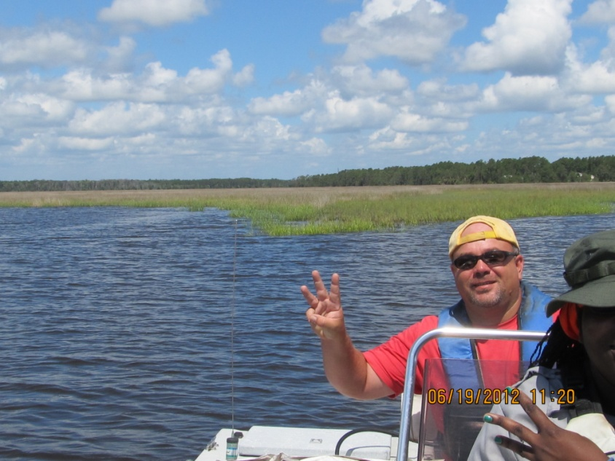
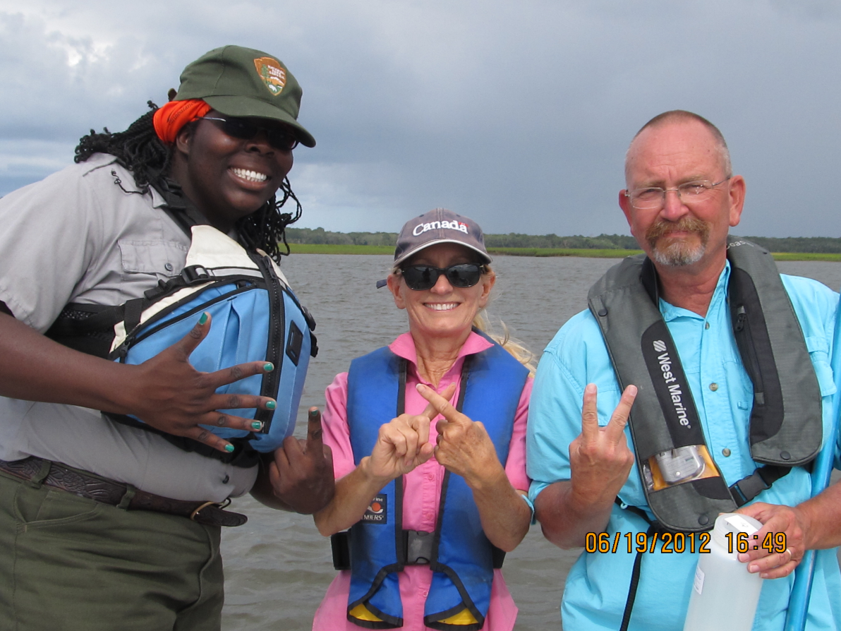
Questions?
Thank you Betsy Deuerling, EQD, and
All Volunteers

